Slide 1


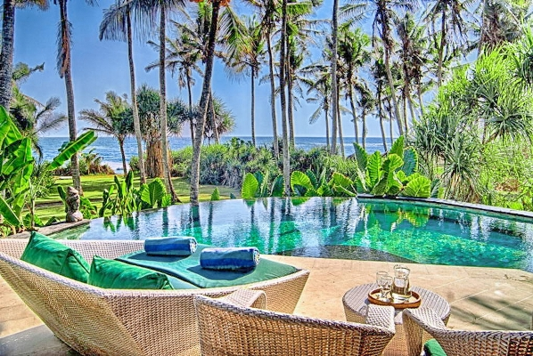

HOTEL MEJBAN MANAGEMENT SYSTEM ADVANCED DATABASE (COMP 214) PRESENTED TO: BLESSING AJIBOYE

Slide 2
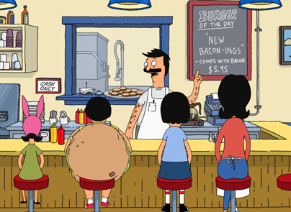
Prepared By:
TAHMINA AHMMED – 300937437 ROJINA AKTER – 300756946 NUSRAT JAHAN – 300967157 DR. MD. FARDOUSH RAHMAN – 300958291 MASUDUR RAHMAN – 300578293 SALIM SAYEED – 300933148 MD HUMAYUN KABIR - 300527330

Slide 3
PROBLEM ANALYSIS
Online international hotel system is very convenient for the people who likes to travel whole world to enjoy their life. The management of Hotel Mejban opted for an online booking system due to their massive losses experienced by current manual system as:
Would be more convenient for customer and employee.
Improve customer service by providing prompt customer support
Reduce operational cost for the company.

Slide 4
FACTS IN THE PROJECT
The elements of the database preparation for the hotel management-
Computerization - All the details regarding hotels, whether it is small or big, will be computerized.
Inventory – If the rooms are provided to the customers, the availability will be reduced in the inventory, and will help in to know the status the available rooms.
Avoid duplication - For every reservation that is conducted of the customers, an automated report will be generated and will be available to the customers and his / her concerned manager uniformly.
Record keeping – It will be easier task for the management to keep the record of the customers for historical purpose.
Booking – It will be easier for both the customers and the receptionist to have the bookings. It is just two clicks away.

Slide 5
SYSTEM MODULES
Rental
The following primary marketing strategies that we use to grow rental revenue and enhance each of our hotel brand.
Internet Marketing: We will make sure your website booking directly to us. We use social media such as Twitter, Facebook, and Trip Advisor to manage and enhance our brands. We also use mobile, email, and pay per click for marketing campaigns.
Sales Calls: We contact to our customers and response them for any information.
Trade Shows: We participate in different trade shows in different fair in whole world.
Incentive Programs: We have good offer for them, who are our regular customers.

Slide 6
SYSTEM MODULES
Car Pick-ups and returns:
Our pick-up and return always free for the customers who booked us and confirmed their payment.
Invoicing and Payment:
Customers always get instant invoice and payment confirmation documents after they confirm their bookings. Moreover, we provide hard copy of invoice according to customers’ request.
General Administration:
The respective departmental heads are very loyal to provide services to our valuable customers. We always prompt our valuable customers to provide their valuable opinion in any aspect.

Slide 7
TABLE DESCRIPTION
COMM_EMPLOYEE table and COMM_ROOMS table_
Attribute | Description | Key Type/ Constraint | Data Type | Length
EMP_ID | ID of employees who work for hotels | Primary Key | VARCHAR2 | 10
FNAME | A first name of an employee |  | VARCHAR2 | 15
LNAME | A last name of an employee |  | VARCHAR2 | 15
ADDRESS | Address of employees |  | VARCHAR2 | 15
POSTALCODE | Postal Code |  | VARCHAR2 | 15
PHONE | Phone Number of employees |  | NUMBER | 15
EMAIL | Email Address | Unique | VARCHAR2 | 15
HOTEL_ID | ID of hotels which employees work for | Foreign Key | NUMBER | 10
Attribute | Description | Key Type/ Constraint | Data Type | Length
ROOM_NO | No of rooms | Primary Key | NUMBER | 10
ROOM_TYPE | Types of rooms |  | VARCHAR2 | 15
ROOMDETAILS | Description of rooms |  | VARCHAR2 | 20
ROOMPRICE | Price of rooms |  | NUMBER | 15
HOTEL_ID | ID of hotels | Foreign Key | NUMBER | 10

Slide 8
TABLE DESCRIPTION
COMM_HOTEL table and COMM_BOOKING table
Attribute | Description | Key Type/ Constraint | Data Type | Length
HOTEL_ID | ID of hotels | Primary Key | NUMBER | 10
NAME | Names of hotels |  | VARCHAR2 | 15
ADDRESS | Address of hotels |  | VARCHAR2 | 15
POSTALCODE | Postal Code |  | VARCHAR2 | 15
PROVINCE | Province |  | VARCHAR2 | 15
TELEPHONE | Telephone Number |  | VARCHAR2 | 15
MANAGER_ID | ID of managers who are in charge of hotels | Unique | VARCHAR2 | 10
Attribute | Description | Key Type/ Constraint | Data Type | Length
BOOKING_ID | ID of booking | Primary Key | NUMBER | 10
CUSTOMER_ID | ID of customers | Foreign Key | NUMBER | 10
ROOM_NO | ID of rooms | Foreign Key | NUMBER | 10
BOOKINGDATE | Date when customers book rooms |  | DATE
CHECKIN | Date of check in |  | DATE
CHECKOUT | Date of check out |  | DATE
NOOFNIGHT | Number of night that customers stay in hotels |  | NUMBER | 15

Slide 9
ENTITY RELATIONSHIP DIAGRAM

Slide 10
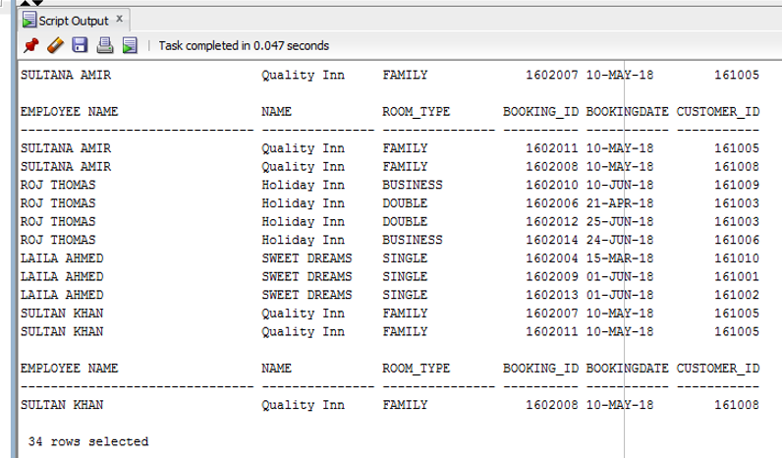
TESTING THE DATABASE-SQL QUERY
Listing data from tables using alias for table name
SELECT E.FNAME || ' ' || E.LNAME AS "EMPLOYEE NAME", H.NAME, R.ROOM_TYPE, B.BOOKING_ID, B.BOOKINGDATE, P.CUSTOMER_ID
FROM COMM_EMPLOYEES E, COMM_HOTELS H, COMM_ROOMS R, COMM_BOOKING B, COMM_PAYMENT P
WHERE E.HOTEL_ID = H.HOTEL_ID AND H.HOTEL_ID = R.HOTEL_ID AND R.ROOM_NO = B.ROOM_NO AND B.CUSTOMER_ID = P.CUSTOMER_ID;

Slide 11
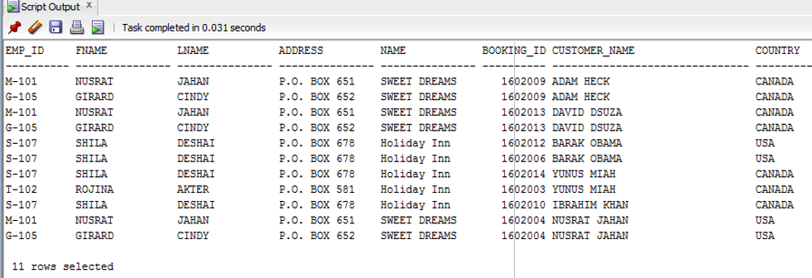
TESTING THE DATABASE-SQL QUERY
List of customer using alias, join, between and LIKE keyword
SELECT E.EMP_ID, E.FNAME, E.LNAME, E.ADDRESS,H.NAME, B.BOOKING_ID, C.FNAME|| ' ' ||C.LNAME AS "CUSTOMER_NAME",
C.COUNTRY FROM COMM_EMPLOYEES E
JOIN COMM_HOTELS H USING(HOTEL_ID)
JOIN COMM_ROOMS R USING (HOTEL_ID)
JOIN COMM_BOOKING B USING (ROOM_NO)
JOIN COMM_CUS_DETAILS C USING (CUSTOMER_ID)
WHERE E.PHONE LIKE '%6%' AND E.ADDRESS BETWEEN 'P.O. BOX 500' AND 'P.O. BOX 700';

Slide 12
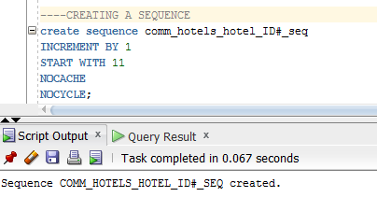
TESTING THE DATABASE-PLSQL QUERY
Creating a Sequence where hotel id will increment by 1

Slide 13
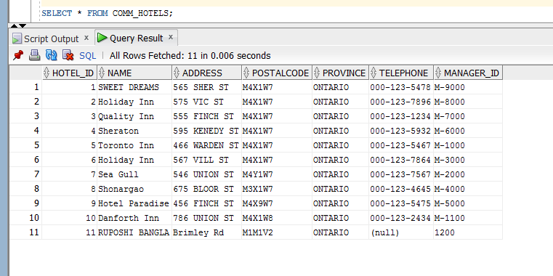
TESTING THE DATABASE-PLSQL QUERY
Insert value using sequence
DECLARE
lv_name_txt comm_hotels.name%TYPE := 'RUPOSHI BANGLA';
lv_address_txt comm_hotels.address%TYPE := 'Brimley Rd';
lv_pcode_txt comm_hotels.postalcode%TYPE := 'M1M1V2';
lv_province_txt comm_hotels.province%TYPE := 'ONTARIO';
lv_manid_txt comm_hotels.manager_id%TYPE := '1200';
BEGIN
INSERT INTO comm_hotels(hotel_ID, name, address, postalcode, province, manager_id)
VALUES (comm_hotels_hotel_ID#_seq.NEXTVAL,lv_name_txt, lv_address_txt,lv_pcode_txt,lv_province_txt,lv_manid_txt);
END;

Slide 14
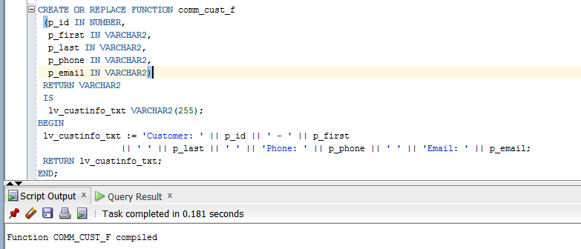
TESTING THE DATABASE-PLSQL QUERY
Create Function

Slide 15
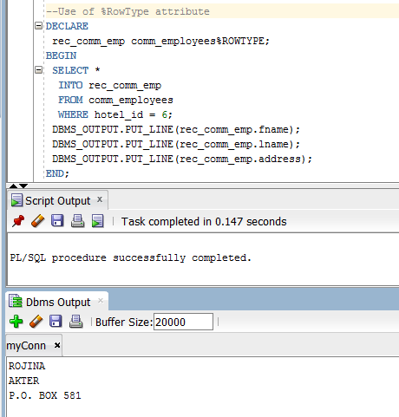
TESTING THE DATABASE-PLSQL QUERY
Use of %RowType attribute to retrieve the employee information with hotel id 6

Slide 16
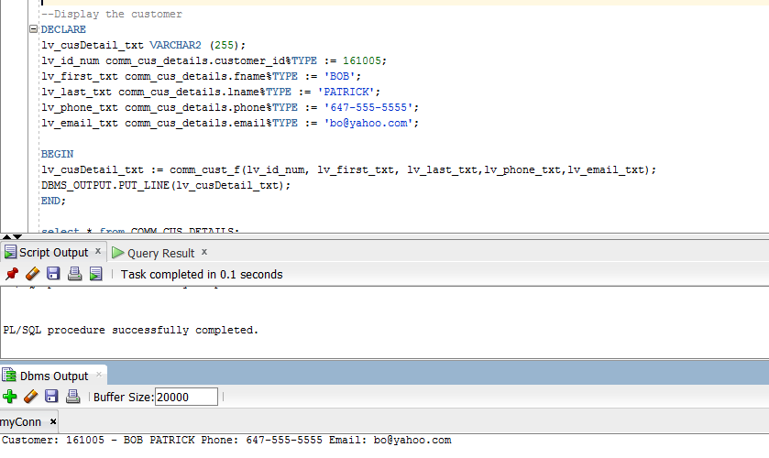
TESTING THE DATABASE-PLSQL QUERY
Display the customer details using the function created

Slide 17
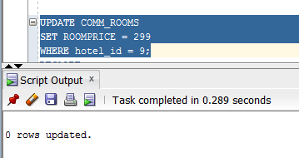
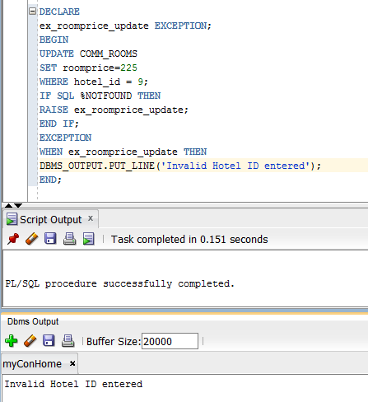
TESTING THE DATABASE-PLSQL QUERY
User define exception for room price with hotel id 9

Slide 18
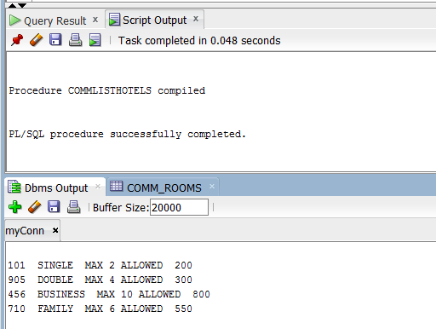
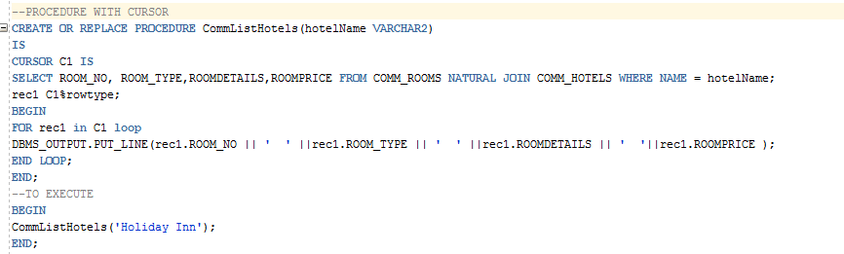
TESTING THE DATABASE-PLSQL QUERY
Creating Cursor and displaying details of rooms available in the hotel Holiday Inn

Slide 19
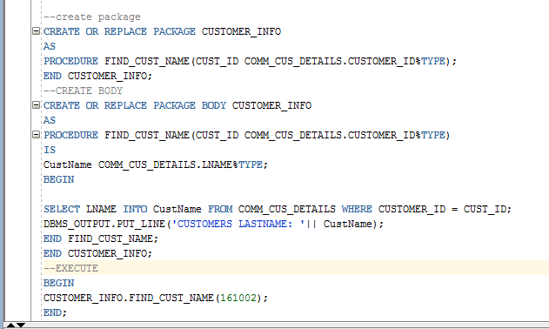
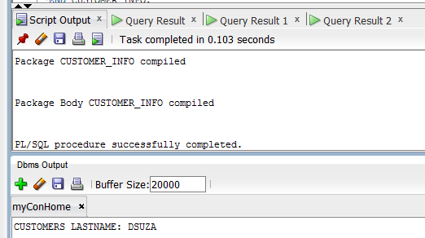
TESTING THE DATABASE-PLSQL QUERY
Creating Package and displaying customers last name according to customer id

Slide 20


